Slide 1

Grant Saggars @ University of Kansas grant-saggars@ku.edu November 4, 2025

Slide 2

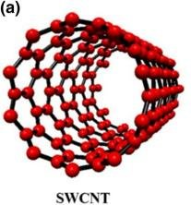
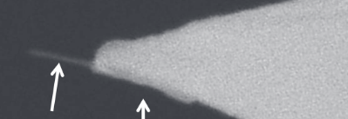

Background & Outline
1. Basics of Conductive Atomic Force Microscopy (C-AFM)
2. Basics of carbon nanotubes (CNTs)
3. Combining the two

Slide 3
When is C-AFM a useful technique?
Conducting Atomic Force Microscopy
1. Capacitance (SCM)
2. Tunneling Behavior (TUNA)
3. Spreading Resistance (SSRM)

Slide 4
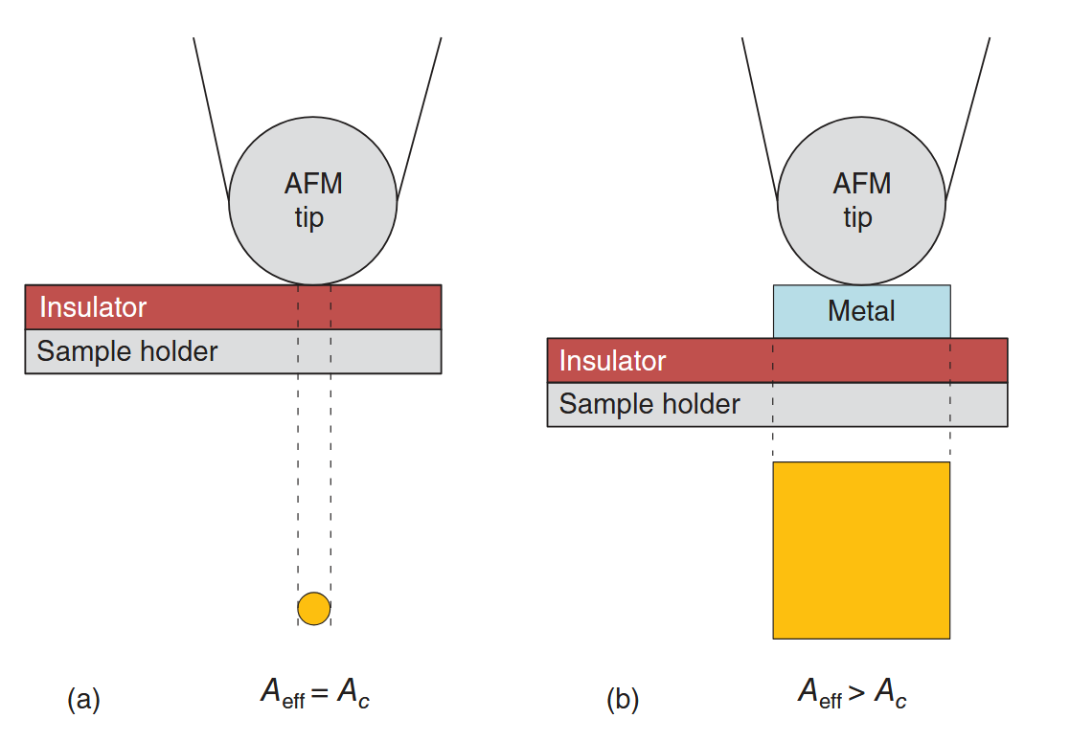
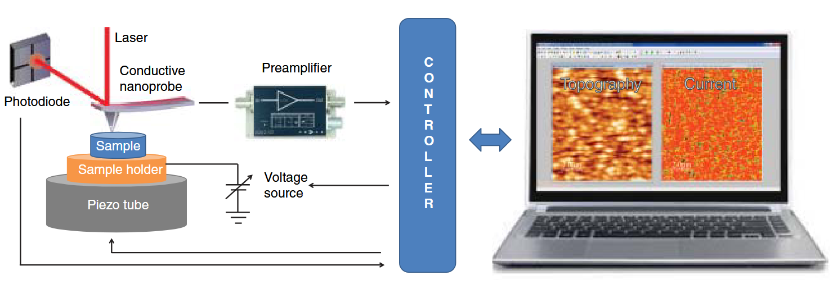
C-AFM Basics
Circa 1996: Record the current flowing at the tip/sample nanojunction simultaneously to the topography.
Figure 1.3 Block diagram of a conventional conductive atomic force microscope. Compared to the AFM, the three new elements are the conductive tip, preamplifier, and sample bias.
C-AFM measures current density; effective area matters.
This is not the same as the sample contact area
The propagation of the electric field is dependent on both the tip and the material
Conductive Atomic Force Microscopy | Wiley Online Books

Slide 5
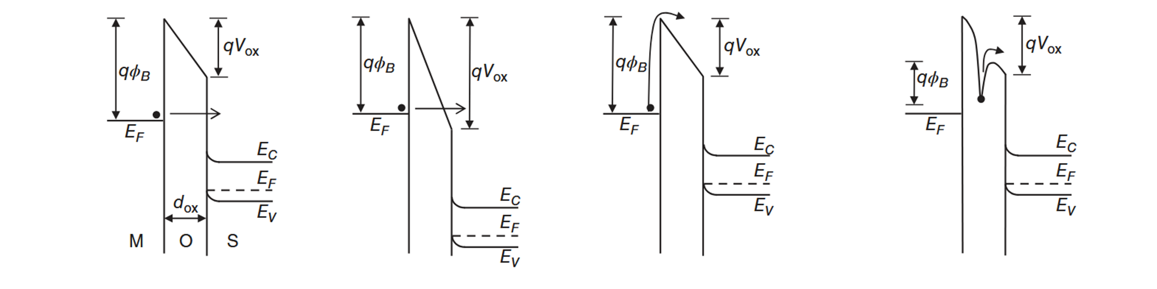
Conduction Processes in Tip/Semiconductor Nanojunctions
Highly insulating, semiconducting
Occurs when tunneling through square barrier
Highly insulating, semiconducting
Occurs when tunneling through trapezoidal barrier
Generally happens in thicker samples
Direct excitation of carriers over barrier
Applies to metal-insulator / insulator-semiconductor interfaces
Shottkey emission is a subclass of Thermionic
Thermal excitation releases “stuck” charges
Direct Tunneling
Fowler-Nordheim
Thermionic Emission
Frenkel-Poole Emission

Slide 6
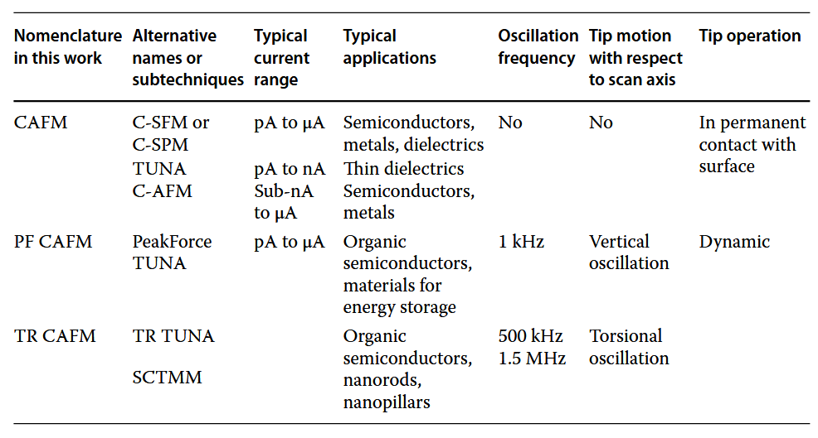
Operation Modes
Conductive Atomic Force Microscopy | Wiley Online Books

Slide 7
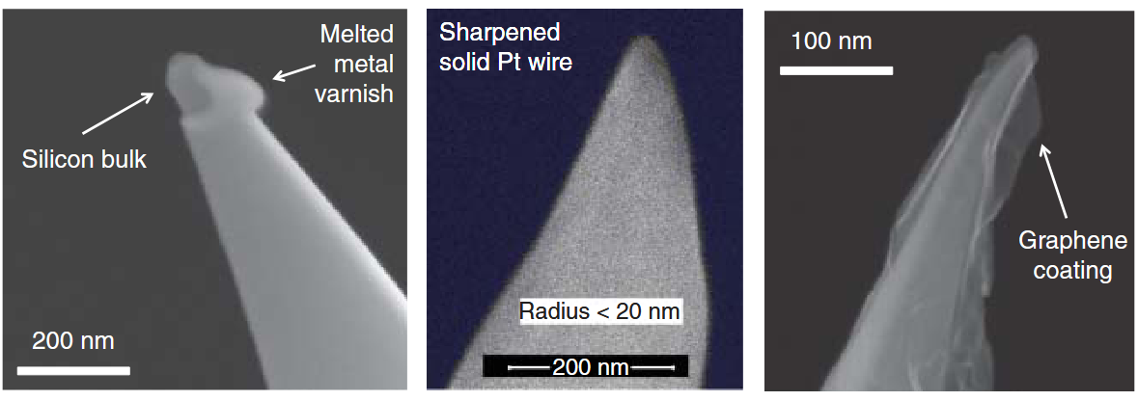
Choice of Probe
Conductive varnish on insulating probe (often, Si)
Optimize varnish thickness against tip diameter
Tips prone to extremely short lifespan
Highly etched & lithographically structured probes (thin films or wire)
Allows fine control over structure and conductivity
Exceedingly difficult to manufacture, sometimes
Tips using a graphene or diamond coating are much more robust and sensitive
Highly robust
Demands tedious fabrication, but can be made in bulk

Slide 8
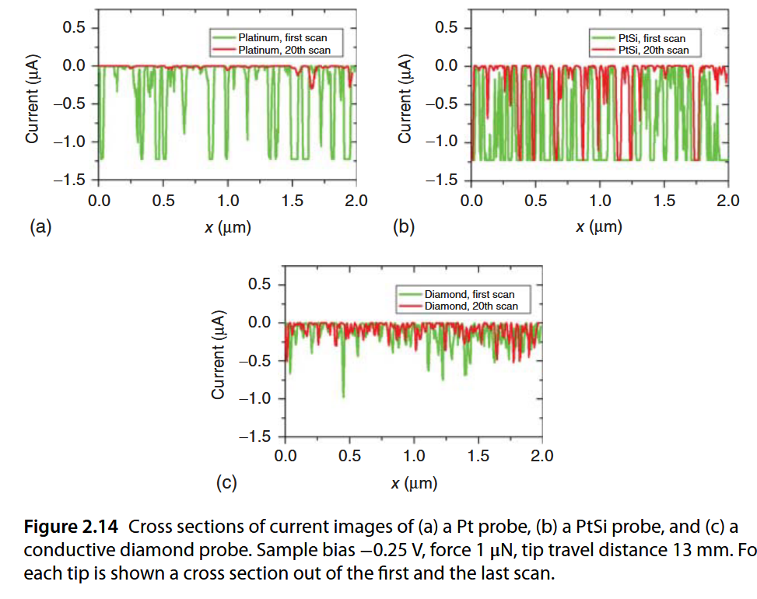
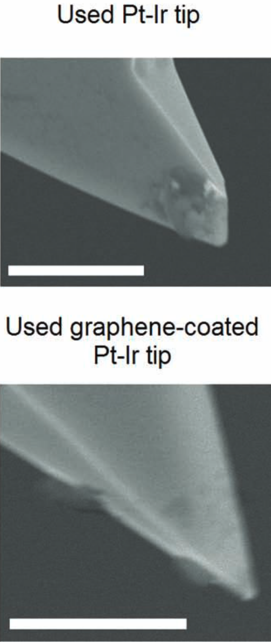
Reliability of Conductive AFM Probes
Metal-varnished tip
Etched & Wire tips
Diamond & Graphene Coated Tips
Used Pt-Ir Tip
Pt-Ir Tip
Conductive Atomic Force Microscopy | Wiley Online Books
M. Lanza, A. Bayerl, T. Gao, M. Porti, M. Nafria, G. Y. Jing, Y. F. Zhang, Z. F. Liu, and H. L. Duan, Advanced Materials 25, 1440 (2013).

Slide 9
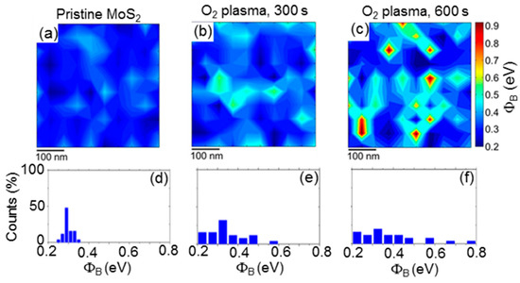
Applications of C-AFM
Year | Achievements
2011 | Monolayer MoS₂ n-type FET with a high-k top gate dielectric
 | Integrated logic circuit based on a single-layer MoS₂
2012 | Monolayer WSe₂ p-type FET with a high-k top gate dielectric
 | Chemical vapor deposition (CVD) of MoS₂ atomic layers on SiO₂ substrates
2014 | FET built from all 2D material components
 | Vertical and in-plane heterostructures of WS₂/MoS₂ monolayers grown by CVD
 | Atomic layer deposition (ALD) of MoS₂ thin films
2015 | CVD of epitaxial monolayer MoS₂ on sapphire
 | Metal organic CVD of a highly uniform monolayer MoS₂ on 100 mm SiO₂ wafers
 | WSe₂-based CMOS and integrated circuits
 | Tunnel diodes based on MoS₂/WSe₂ vdW heterostructures grown by CVD
2016 | MoS₂ FET with a 1 nm gate length
 | MoS₂ FET with a sub −10 nm channel length
 | CVD of epitaxial monolayer MoS₂ on gallium nitride
 | Pulsed laser deposition (PLD) of MoS₂ thin films
2017 | Ambipolar MoS₂ FET by tailoring the Schottky barrier with oxygen plasma
 | Ohmic contacts to monolayer MoS₂ by van der Waals bonded metal/h-BN electrodes
 | Demonstration of a microprocessor based on CVD grown bilayer MoS₂
 | Hot electron transistor with GaN emitter, graphene base, and WSe₂ base-collector barrier
2018 | Batch CVD growth of uniform monolayer MoS₂ on 150 mm soda-lime glass wafers
2019 | Van der Waals contacts between 3D metals and 2D semiconducting TMDs
(ACS 2017) Shottky Barrier Tuned via Plasma Treatment in 2D MoS₂
Schottky barrier height maps and histograms on pristine MoS₂ (a,d) and after O₂ plasma for 300 (b,e) and 600 s

Slide 10
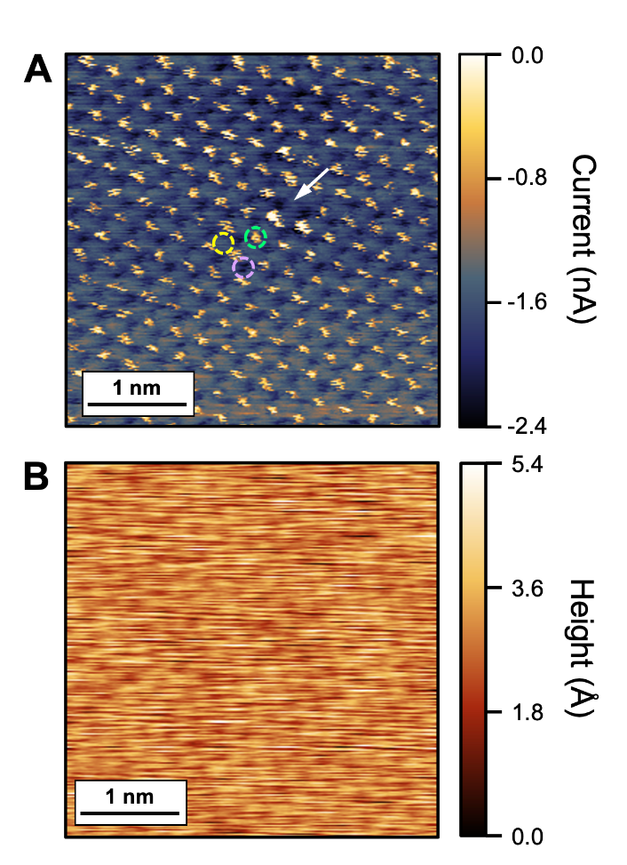
Final Notes on C-AFM: Atomic Resolution Possible (sometimes)
Note- current is dependent on the effective area between the tip and sample
Insulating samples are therefore easier to probe at high resolution
S. A. Sumaiya and M. Z. Baykara, True Atomic-Resolution Imaging under Ambient Conditions via Conductive Atomic Force Microscopy, (n.d.).

Slide 11
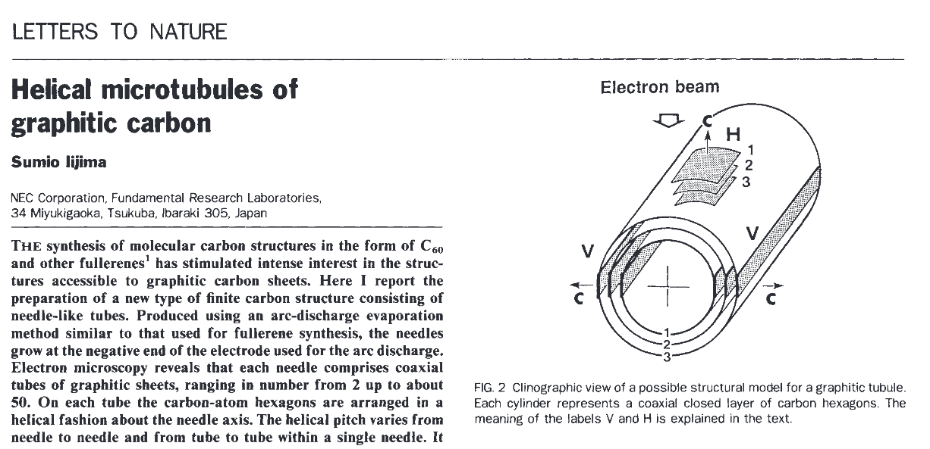
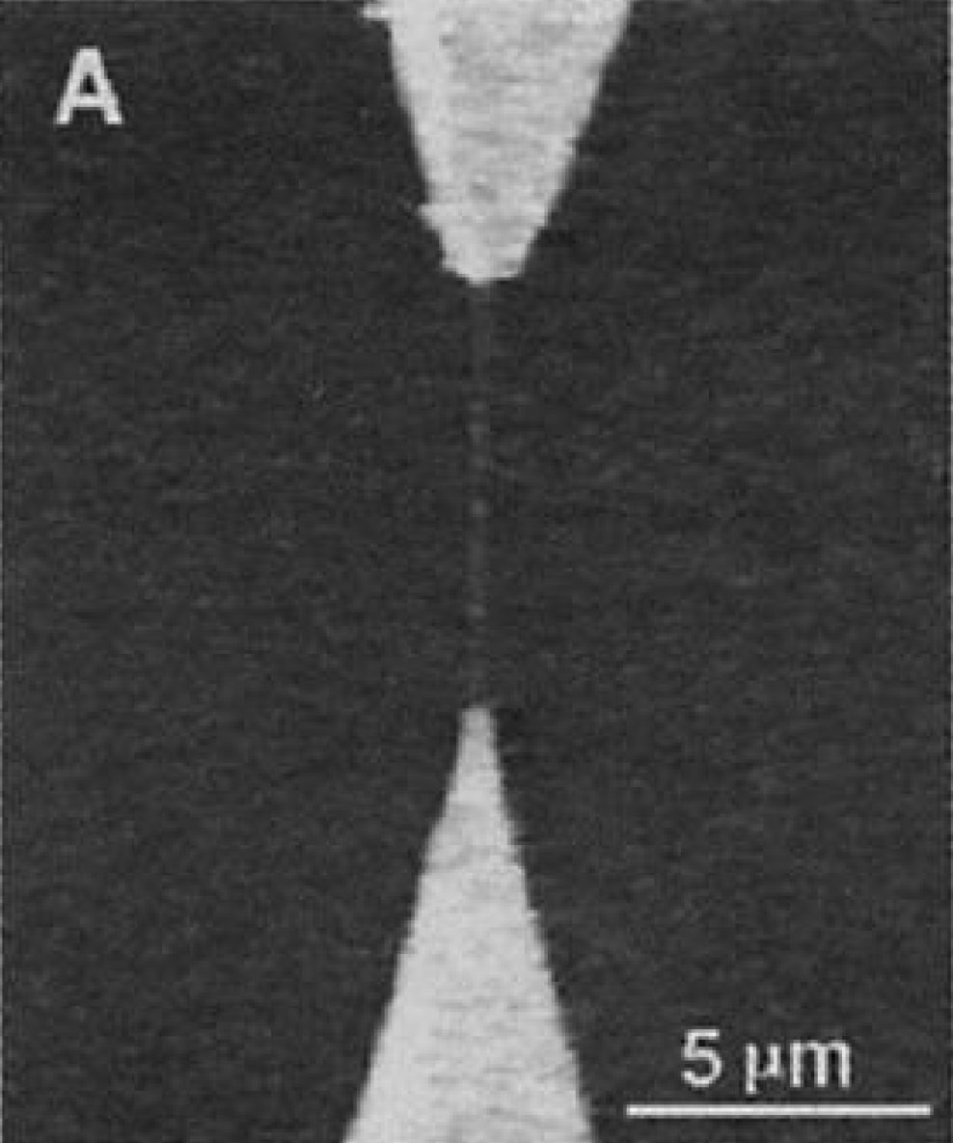
Development of Carbon Nanotubes
Multi-walled carbon nanotubes (MWCNT) become a “hot” research area
Experimental characterization of structural, thermal, electronic properties
First single-walled carbon nanotubes (SWCNT) fabricated
CNT Sensors
Quantum wire applications
Li-ion batteries
Commercial use: composites, high lubricity, thermal interfaces
(1991)
(1993)
(2000-2001)
(today)

Slide 12
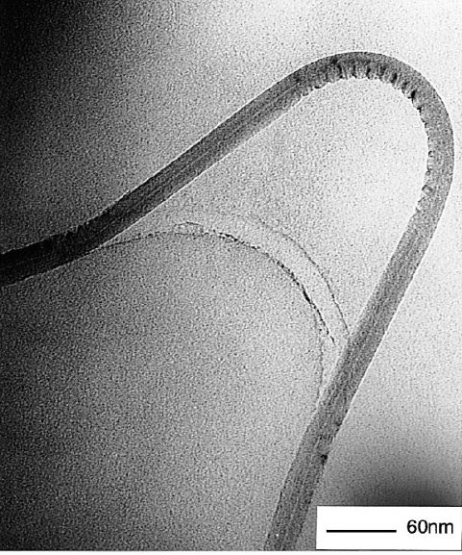
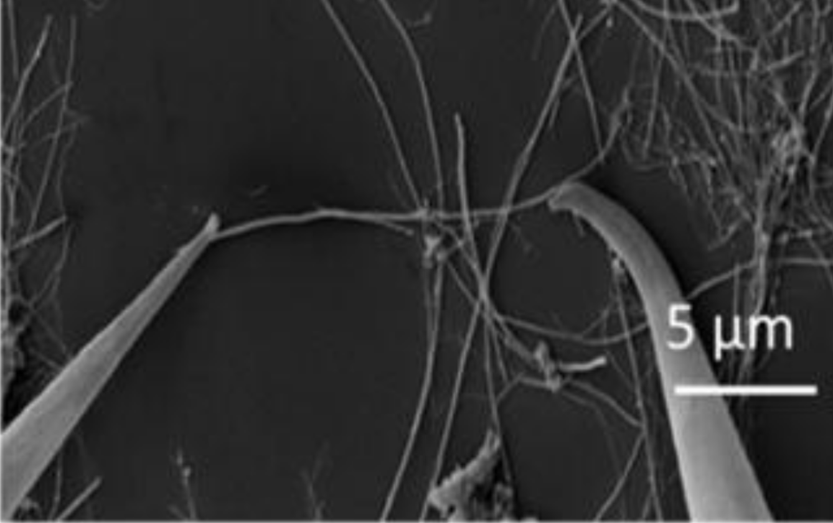
Fact Sheet
Synthesis has been developed for 30+ years; not challenging to grow or purchase
Enables probes with tip diameter <15 nm
Can be made highly conductive or semiconducting
SWCNT conductance up to ~10⁷ A/mm²
Copper conductance around ~5.8 x 10⁷ A/mm²
Can be engineered by chirality, defects, doping
Cylinders buckle when stressed
Conductivity not lost when this happens
Extreme Aspect Ratio (>0.1ᴇ⁹:1)
Highly Tunable Electronic Modes
Structural Integrity
Y. Xiang, L. Zhang, and C. Liu, Nanomaterials 15, 1165 (2025).
Y. Xiang, L. Zhang, and C. Liu, Nanomaterials 15, 1165 (2025).
H. Shima, Buckling of Carbon Nanotubes, Materials 5, 47 (2012).

Slide 13
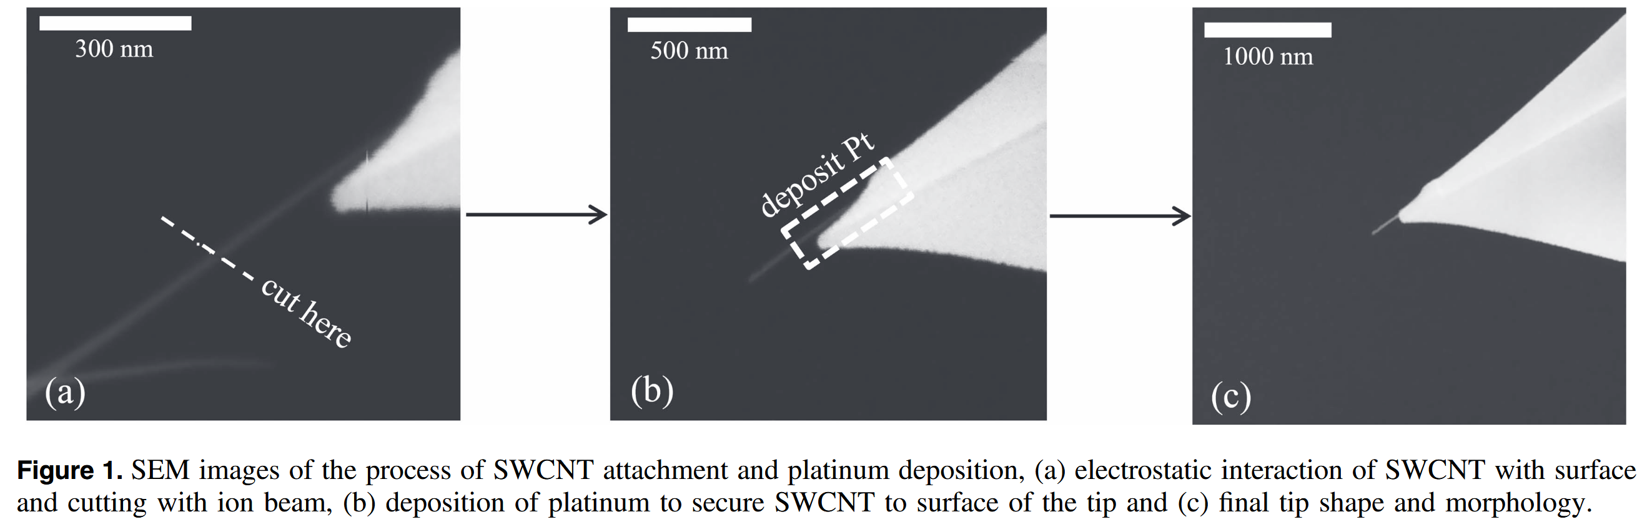
Carbon Nanotubes as C-AFM Probes
Attach via micromanipulator and some carbon paste
Cut with FIB for greater integrity
Weld to probe using electron beam deposition
*there exist other methods for attachment, which can require less equipment
A. D. Slattery, C. J. Shearer, C. T. Gibson, J. G. Shapter, D. A. Lewis, and A. J. Stapleton, Nanotechnology 27, 475708 (2016).

Slide 14
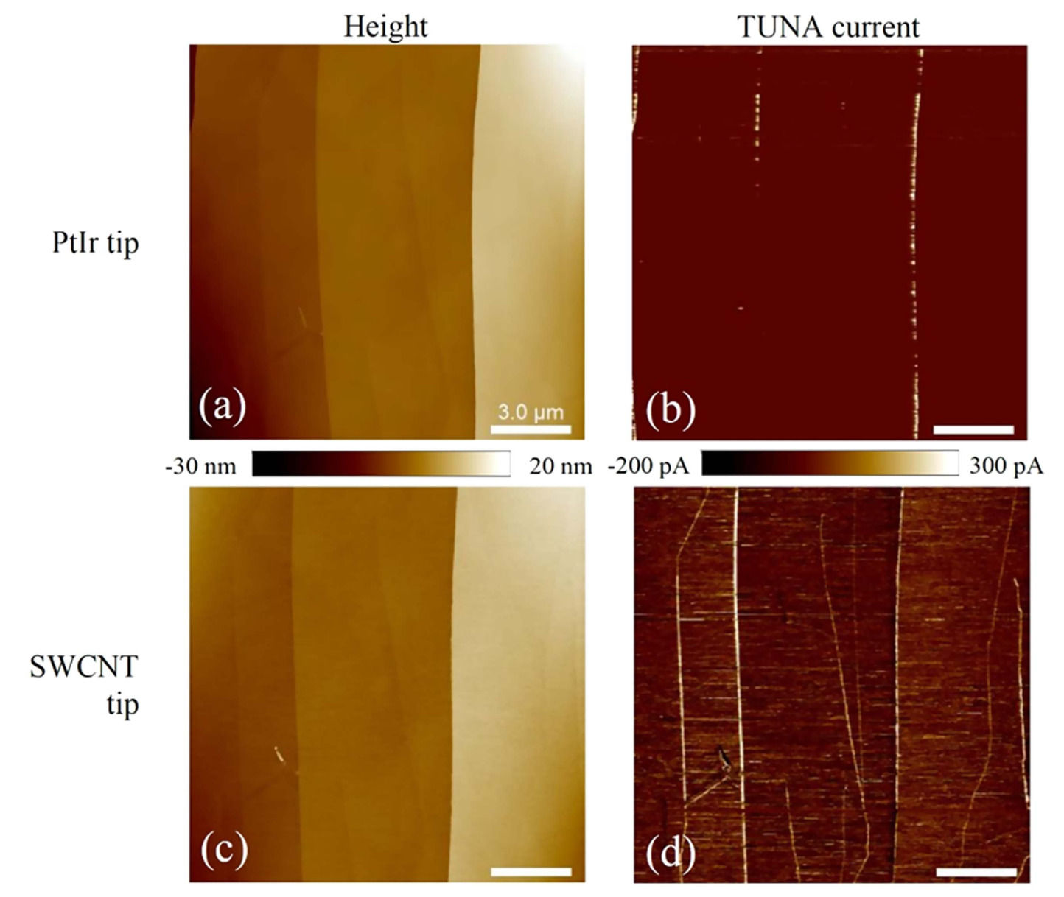
Carbon nanotubes as a path to overcome traditional C-AFM limitations
Stable, sensitive conductance
Improved contrast over typical Pt-Ir tips
CNTs more conductive than most materials
Signal integrity unlikely to degrade compared to other tips
Comparison in terms of imaging performance on a sample of highly ordered pyrolytic graphite (HOPG).
A. D. Slattery, C. J. Shearer, C. T. Gibson, J. G. Shapter, D. A. Lewis, and A. J. Stapleton, Nanotechnology 27, 475708 (2016).

Slide 15
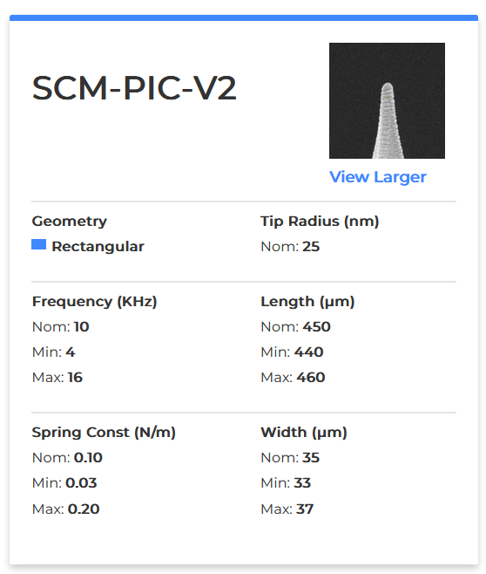
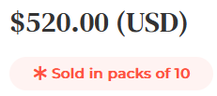
Carbon nanotubes as a path to overcome traditional C-AFM limitations
2. Structural Integrity and Repairability
The authors use a small bundle of SWCNTs
Slightly larger diameter but much better resilience
Authors note CNTs are prone to buckling instead of chipping
CNT-tips offer the ability to repair a tip

Slide 16
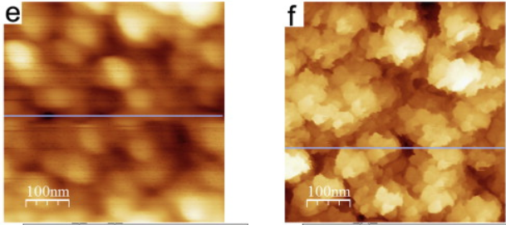
Carbon nanotubes as a path to overcome traditional C-AFM limitations
Au-coated Si Tip
3. Improved tip diameter
May or may not improve spatial resolution of C-AFM very much (depends on sample)
This does give big improvements to topology map (which can be gathered simultaneously)
Necessary for characterization of nanoelectronics
CNT Tip
J. Xu, Y. Shingaya, Y. Zhao, and T. Nakayama, Applied Surface Science 335, 11 (2015).

Slide 17
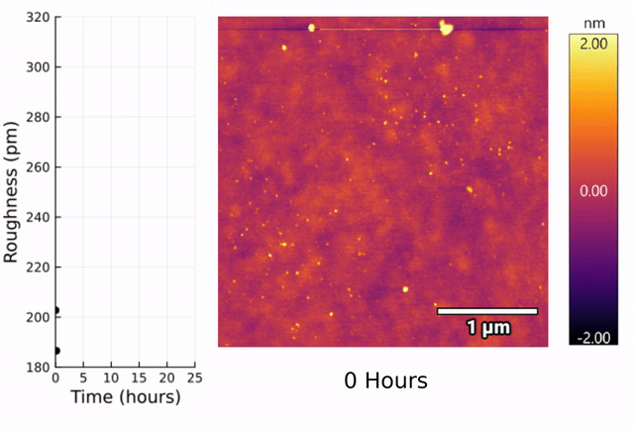
Potential research directions
Little work has been done using such tips explicitly yet (I think)
Such long-duration experiments (such as extended chemical reactions) cannot be imaged using most C-AFM probes
(Hundreds of scans required)
V. Jain*, S. Ahsanullah*, G. Saggars*, A. Mathai*, D. Pates, A. Guardiola, K. Watanabe, T. Taniguchi, M. A. McGuire, D. Graf, M. Gibertini, A. F. May, D. Ovchinnikov, “Electrical detection of magnetic states in G-type van der Waals antiferromagnet”, In Preparation (2025)

Slide 18
That’s all! grant-saggars@ku.edu November 4, 2025

